Slide 1
AS91896(2.7) & AS91887(2.8) Documentation
Jack Percy

Slide 2
Monster Cards
Link to GitHub Repository: https://github.com/Jaxku/Assessment---Monster-Cards
Links to Trello board / project management tools: https://trello.com/b/xUnBLKAl/monster-cards
Link to final version of your program: https://github.com/Jaxku/Assessment---Monster-Cards/blob/main/monsterCardFinal.py
Ensure you have made these links ‘public’ so that they are open to anyone, including the marker. The link to your program is the final outcome of this whole project – your finished program.

Slide 3
Explain relevant Implications: (1/2)
Additional rows can be added by clicking in the last cell and then using the Tab key
Relevant implication | Explain the implication and say how it is relevant to this project
Using a graphical interface | Using a graphical interface for this project can benefit the end-user, including ease of use, intuitive navigation, and a reduced learning curve when using the program. With a graphical interface, users can interact with the project using visual elements such as icons, buttons, and menus, which makes it easier for them to understand and use the software without needing extensive technical knowledge, such as reading an output in a python terminal which can be muddled and confusing for a beginner user.
Usability | Usability is about how easily the user can get the program to achieve what it was designed to achieve. It deals with issues like making instructions and error messages clear and easy for users to understand. It is vital to eliminate any frustration to have a good user satisfaction.
Notes:
Additional rows can be added by clicking in the last cell and then using the Tab key

Slide 4
Explain relevant Implications: (2/2)
Additional rows can be added by clicking in the last cell and then using the Tab key
Relevant implication | Explain the implication and say how it is relevant to this project
Aesthetics | In the context of the program, aesthetics play an important role in its overall user experience. The program's appearance, such as its use of spacing and formatting for instructions and prompts, can significantly impact how aesthetically pleasing and user-friendly it is. A program that is well-designed and visually appealing is likely to be more enjoyable and engaging for users than one that appears unpolished and lacking in aesthetic appeal. Therefore, paying attention to the program's aesthetics is important for creating a positive user experience.
Intellectual Property/Copyright | As I develop my project, it's essential to ensure that all content used, including questions, code snippets, and images, are either created by me, in the public domain, or under a Creative Commons license that has been appropriately attributed. This precaution is crucial to avoid legal complications and to maintain originality in the project. By taking this approach, I can ensure that the project is legally sound and upholds ethical standards.
Notes:
Additional rows can be added by clicking in the last cell and then using the Tab key

Slide 5
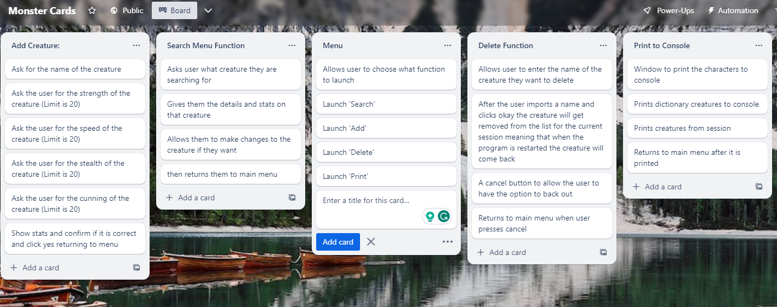
Decomposition:
Paste screenshots of your initial Trello board / task decomposition on this slide. If you have a long list, you might need to break it up into several slides.
Notes:
Paste screenshots of your initial Trello board / task decomposition on this slide. If you have a long list, you might need to break it up into several slides.

Slide 6
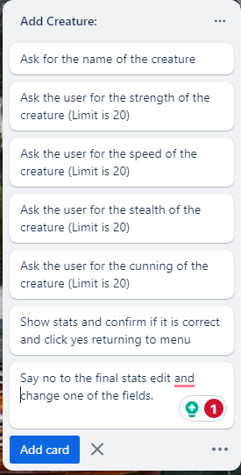
Component 1 (Add Creature)

Slide 7
Add Creature - Test Plan (1/2)
What Program Should Ask | Test Cases - input | Expected output
Enter the name of the creature you want to add: | Joe | Moves Forward in the program (Asks for strength)
Enter the strength of the creature | 10 | Moves Forward in the program (Asks for Speed)
Enter the speed of the creature | 10 | Moves Forward in the program (Asks for Stealth)
Enter the stealth of the creature | 10 | Moves Forward in the program (Asks for Cunning)
Enter the cunning of the creature | 10 | Moves forward in the program. (Shows confirmation screen)
Notes:
Additional rows can be added by clicking in the last cell and then using the Tab key

Slide 8
Add Creature - Test Plan (2/2)
What Program Should Ask | Test Cases - input | Expected output
(Confirmation Screen) “Are these details correct?” | No | (Pop-up Screen) Which Field would you like to change? (Buttons) Strength, Speed, Stealth, Cunning
(Pop-up Screen) Which Field would you like to change? (Buttons) Strength, Speed, Stealth, Cunning | Cunning | Enter the new value for Cunning
Enter the new value for Cunning | 26 | ERROR: The value you entered is greater than the upper bound of 26. (Allows the user to reinput the value for cunning)
Enter the new value for cunning | 11 | (Pop-up) Confirmation Screen
Are these details correct? | Yes | Creature added successfully!
Notes:
Additional rows can be added by clicking in the last cell and then using the Tab key

Slide 9
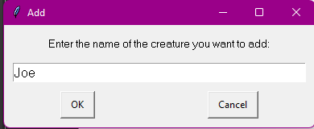
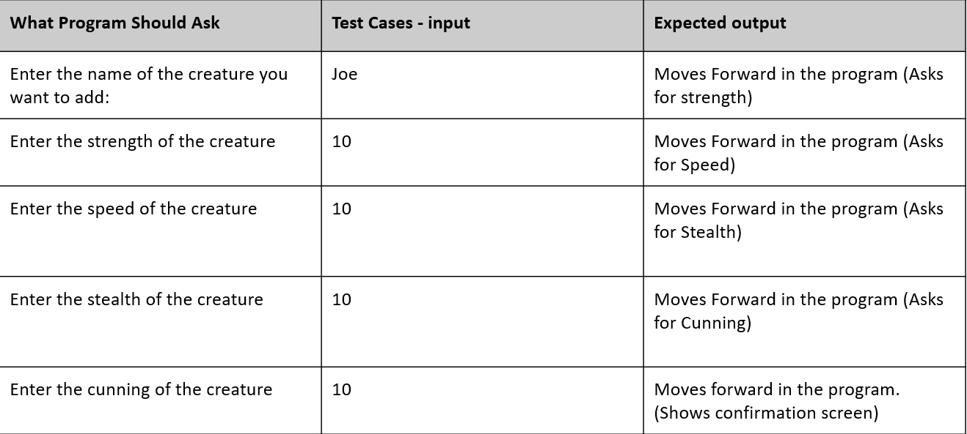
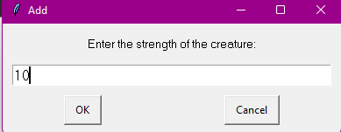
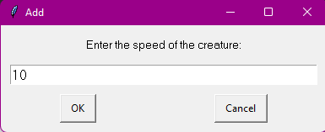
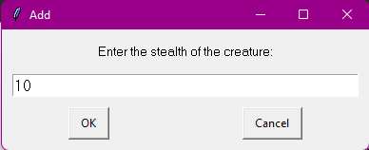
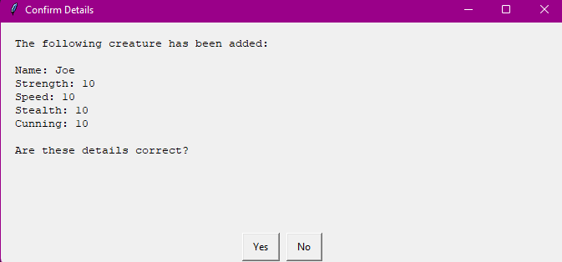
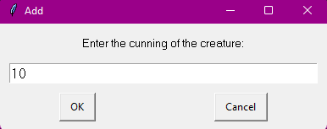





Add Creature: Testing (1/2)
After each input, the program reacts as expected and moves forward in the program.
Notes:
You must show the results of testing. For each component, include a screenshot proving it works. You can also include notes about each test.

Slide 10
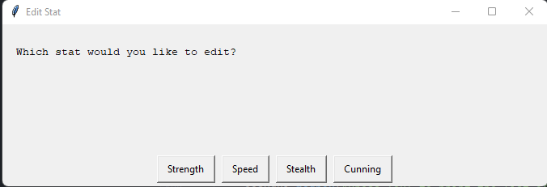
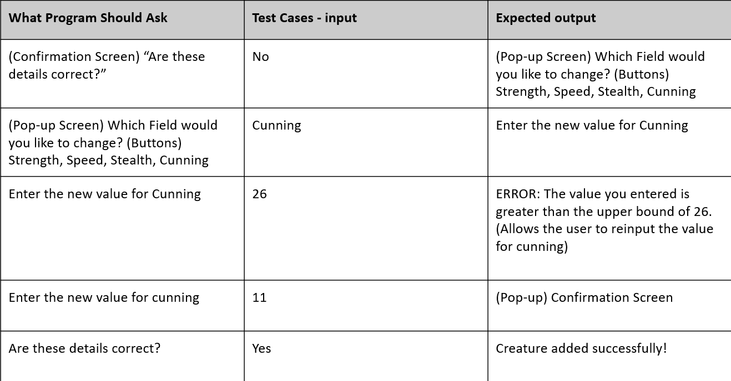
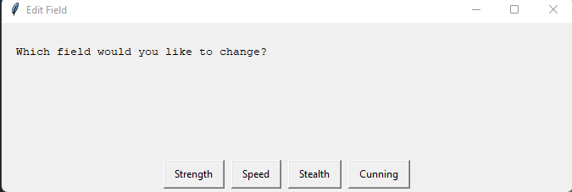
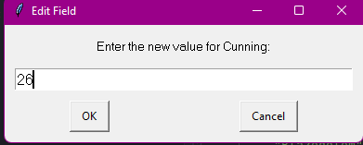
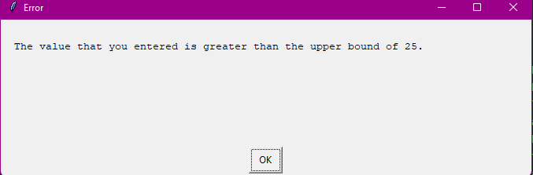
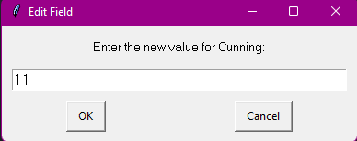
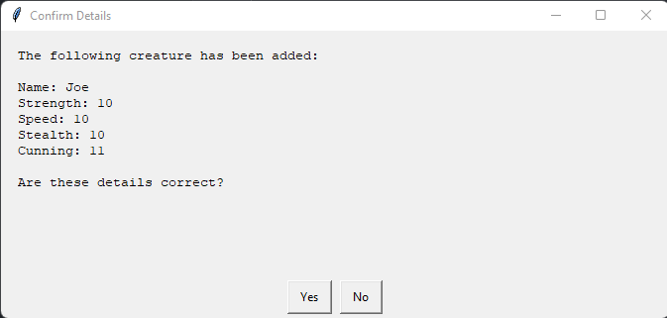
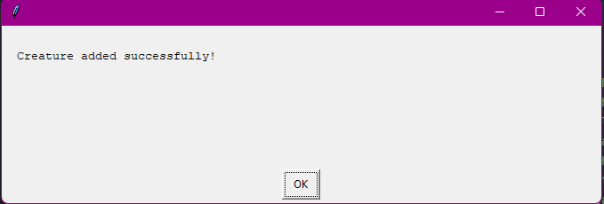
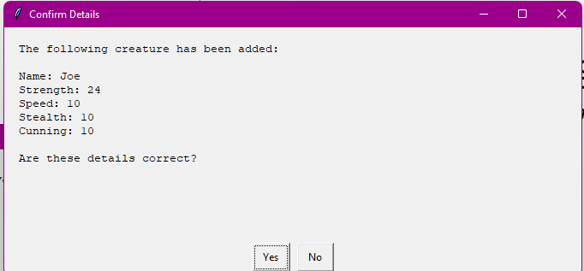














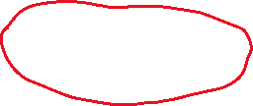
Add Creature: Testing (2/2)
After each input, the program reacts as expected and moves forward in the program.
Notes:
You must show the results of testing. For each component, include a screenshot proving it works. You can also include notes about each test.

Slide 11
Add Creature: Trialling
Trial 1 04_addCreature_v1.py | The program works but is very basic and lacks features that would benefit the end-user, such as no ability to confirm the character’s stats before adding it to the program. Also, the upperbound doesn’t match the program and project brief. (v2 fixes this problem but remains the same)
Trial 2 04_addCreature_v3.py | V3 adds to v1/v2 and adds the ability to confirm the characters stats before adding it to the ‘system’ it also allows the user to change stats on the confirmation screen if they made a mistake which fits with the usability relevant implication. (v4 fixes PEP8 issues)
Trial 3 04_addCreature_v5.py | The code is based off of v4 the only change in v4 is it fixes PEP8 issues. In this final version, I Make the language used in the message boxes more general and cool. This will be used in the final program as it works the best and is the most fir for purpose version of this function.
End user feedback:
Michael (Older brother no python experience):
From using all the versions and giving feedback to the first few versions to make sure its easier for everyone to use such as being able to confirm the creatures stats before adding it to the program just in case the end user like me made a mistake and needs to adjust one of these variables fin the creature.
Notes:
NOTE: Trialling needs to happen for at least 2 of your components but is not necessary for ALL components.
Trialling is not the same as testing. Trialling is about finding different ways of building the same component. Show evidence of your trialling here. Select one of your trials for further development and give reasons for your choice.

Slide 12
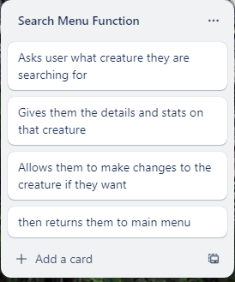
Component 2 (Search Creature [03_searchMenuFunction])

Slide 13
Search Menu Function: Test Plan
What Program Should Ask | Test Cases - input | Expected output
‘Enter the name of the creature you want to search for.’ | ‘Rotthing’ (Creature from dictionary) | Displays creatures details.
User presses ‘OK’ on previous details screen allowing them to search for another creatures | ‘Joe’ (Creature from session (Made from add creature function.) | Displays creature details
User presses ‘Edit Stats’ on previous details screen. | User presses ‘speed’ – Changes to ‘10’ – User presses ‘ok’ | Displays new creature details.
Previous details screen displays ‘Ok’, ‘Edit Stats’, ‘Return to Main Menu’ | Return to Main Menu. | Returns to Main Menu
Notes:
You must show the results of testing. For each component, include a screenshot proving it works. You can also include notes about each test.

Slide 14
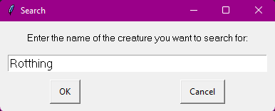
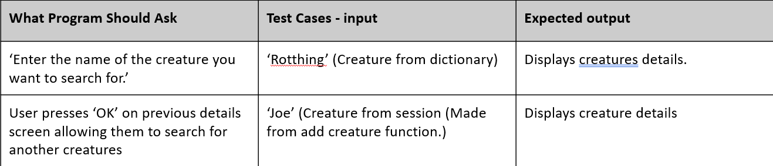
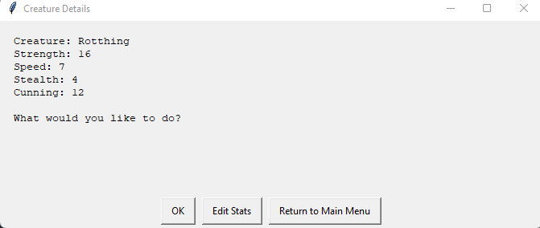
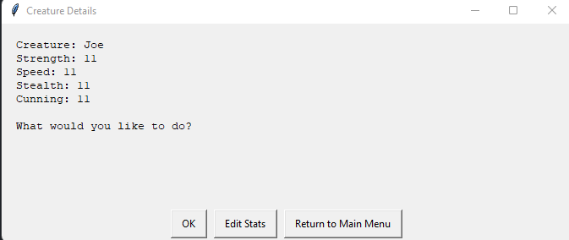
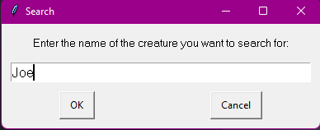

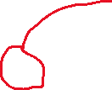





3) Search Menu Function: Testing (1/2)
Notes:
You must show the results of testing. For each component, include a screenshot proving it works. You can also include notes about each test.

Slide 15
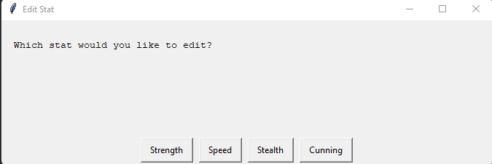
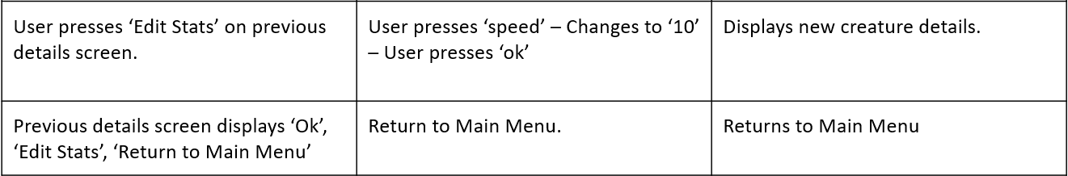
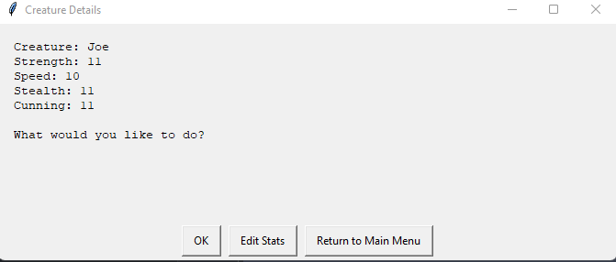
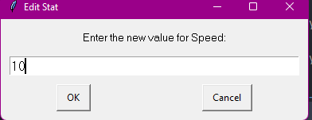
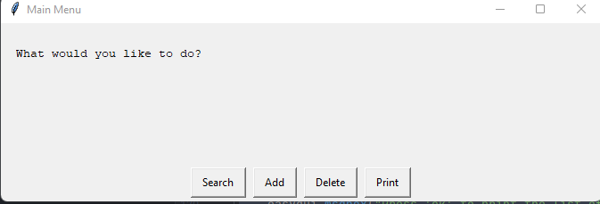







Search Menu Function: Testing (2/2)
Notes:
You must show the results of testing. For each component, include a screenshot proving it works. You can also include notes about each test.

Slide 16
Search Menu Function: Trialling
Trial 1 03_searchMenuFunction_v1.py | This version of the function is very simple; it allows the user to search the creature dictionary, but the name of the creature must match the name in the dictionary. It does not allow the user to search for creatures made in the current session. When a user searches for a creature, the program only produces the output “Creature Found,” it doesn’t contain any information on the character itself which is improved on in later versions.
Trial 2 03_searchMenuFunction_v2.py | Based on v1 to expand on the function when a creature is found, it displays the info of the character using an EasyGUI Message Box. This version still needs the user to make sure the capitalization of each letter is correct.
Trial 3 04_addCreature_v5.py | Based on previous versions, this version of the program allows the user to search for the creature and if the user accidentally doesn’t write the creatures name with a capital it will still be able to find the creature. This addition of the function also allows the user to edit the stats of the creature they are searching for. This will be used in the final program as it works the best and is the most fir for purpose version of this function.
Notes:
NOTE: Trialling needs to happen for at least 2 of your components but is not necessary for ALL components.
Trialling is not the same as testing. Trialling is about finding different ways of building the same component. Show evidence of your trialling here. Select one of your trials for further development and give reasons for your choice.

Slide 17
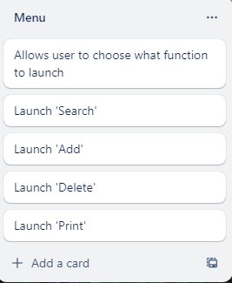
Component 3 (Menu [searchMenuFunction])

Slide 18
Menu Function: Test Plan
What Program Should Ask | Test Cases - input | Expected output
What would you like to do? [Choices Search, Add, Delete, Print] | Search | (Launches Search Function)
What would you like to do? [Choices Search, Add, Delete, Print] | Add | (Launches Add Function)
What would you like to do? [Choices Search, Add, Delete, Print] | Delete | (Launches Delete Function)
What would you like to do? [Choices Search, Add, Delete, Print] | Print | (Launches Print Function)
Notes:
You must show the results of testing. For each component, include a screenshot proving it works. You can also include notes about each test.

Slide 19
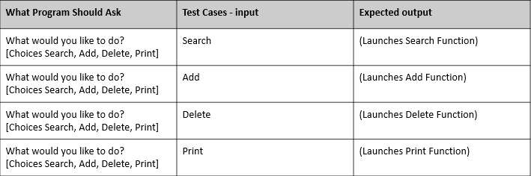
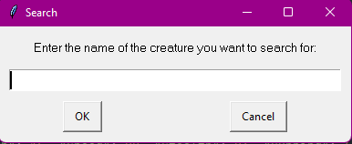
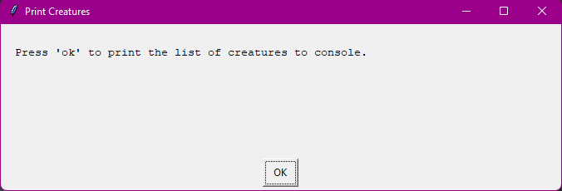
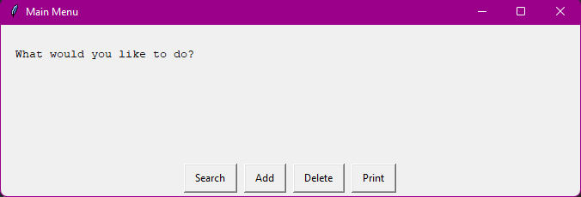
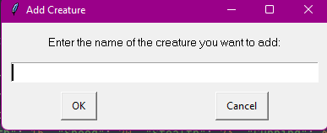
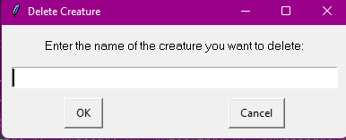
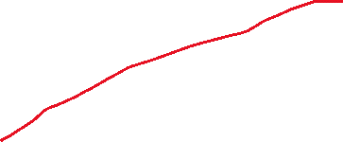
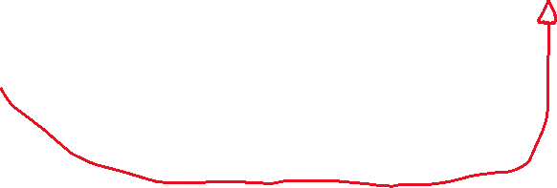







Menu Function: Testing
Each button launches the corresponding function as expected to fit the test plan.
Notes:
You must show the results of testing. For each component, include a screenshot proving it works. You can also include notes about each test.

Slide 20
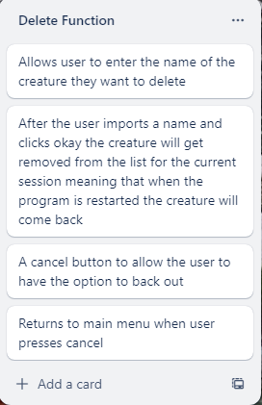
Component 4 (Delete Creature [05_deleteCharacter])

Slide 21
Delete Function: Test Plan
What Program Should Ask | Test Cases - input | Expected output
Asking the user what creature, they want to delete. | Rotthing (Dictionary Creature) | “Rotthing deleted from the current session”
Asking the user what creature, they want to delete. | joe (Session Creature) | “Joe deleted from the current session”
Asking the user what creature, they want to delete. | (User presses cancel button) | Program returns to main menu
Notes:
You must show the results of testing. For each component, include a screenshot proving it works. You can also include notes about each test.

Slide 22
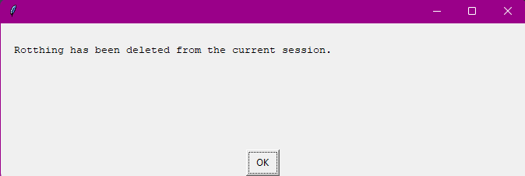
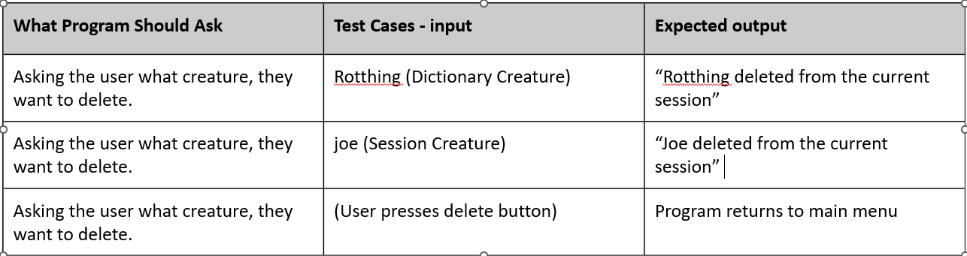
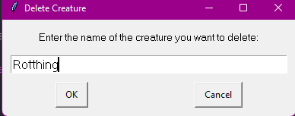
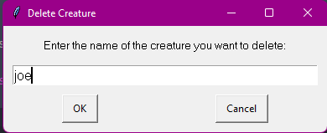
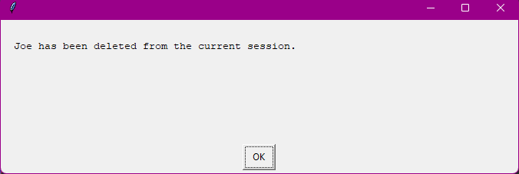

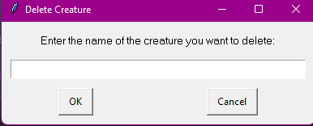
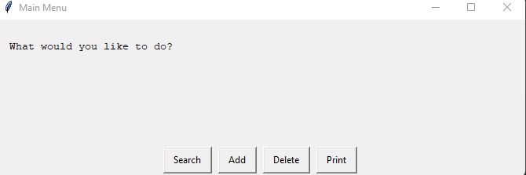







Component 4 Delete Creature: Testing
The delete function works as expected and has been tested comprehensively

Slide 23
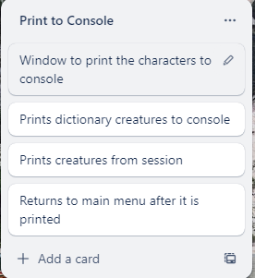
Component 5 (Print to Console [06_printConsole])

Slide 24
Print to Console Function: Test Plan
What Program Should Ask | Test Cases - input | Expected output
Press ‘ok’ to print the list of creatures to console | User presses ‘OK’ | Prints creatures both dictionary and session to console and returns to main menu
Notes:
You must show the results of testing. For each component, include a screenshot proving it works. You can also include notes about each test.

Slide 25
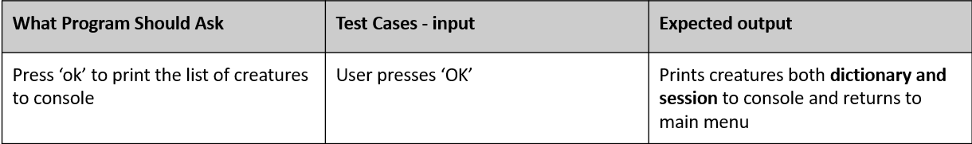







Component 5 (Print to Console [06_printConsole]) - Testing
When the print creature function is launched from the main menu and the user presses ‘ok’ it prints the list of creatures to the console as expected from the program brief.
It prints both from the dictionary and the temporary creatures.

Slide 26
Assembled Outcome Testing Main Menu and Search Funtion:
What Program Should Ask | Test Cases - input | Expected output
Run Program: Ask user what they want to do (Main Menu) | User presses ‘Search’ | Launches Search
Asks user what to search for | Searches ‘Rotthing’ | Displays stats
What would you like to do? | User ‘Edit stats’ and changes speed to 25 | Shows new stats
Asks use what they want to do | Return to main menu | Returns to main menu
Notes:
Show testing for your assembled outcome below. This should include a test plan followed by screenshot proof.

Slide 27







Assembled Outcome Testing Main Menu and Search Function:
This testing on the assembled outcome based on the test plan from the previous slide shows that the search function and main menu function, which are two separate functions work together seamlessly with no errors.
The red boxes show cases the user input.
Notes:
Show testing for your assembled outcome below. This should include a test plan followed by screenshot proof.

Slide 28
Assembled Outcome Add creature, delete creature:
What Program Should Ask | Test Cases - input | Expected output
User clicks search on main menu | Adds creature called Joe and fills in all details | Displays details. Then returns to main menu from user input
Main Menu | User launches delete | Opens delete function seamlessly
What creature are you going to delete | Joe | Deletes Joe
Notes:
Show testing for your assembled outcome below. This should include a test plan followed by screenshot proof.

Slide 29






Assembled Outcome Add creature, delete creature:
Missing dialogue boxes of the stats for the creatue as not required to showcase these functions working together.
This testing on the assembled outcome based on the test plan from the previous slide shows that the Add creature and delete, which are two separate functions, work together seamlessly with no errors. For example for a user-added character the delete function is able to delete the creature
The red boxes showcases the user input.
Notes:
Show testing for your assembled outcome below. This should include a test plan followed by screenshot proof.

Slide 30



Assembled Outcome print:
What Program Should Ask | Test Cases - input | Expected output
Main menu (options listed | Print | Print functions runs seamlessly
Returns to main menu
Based on the test plan from the previous slide, this testing on the assembled outcome shows that the main menu, print, and add creature, which are three separate functions, work together seamlessly with no errors. For example, the add creature function works with the print function as it displays the stats of the creature created using the add function
As seen above joe which is a creature made in the session is included with the full print of creatures showing that they work together in an assembled project.
Notes:
Show testing for your assembled outcome below. This should include a test plan followed by screenshot proof.

Slide 31
Address relevant Implications: (1/2)
Relevant implication | Explain how your final outcome addresses each implication
Using graphical interfaces | In this project, a graphical interface can make it easier for users to manipulate and visualize data, reducing the time and effort required to analyse and understand complex information. It can also make it easier to identify and resolve errors, reducing the risk of data loss or corruption.
Functionality | After testing the code to see if it works fine I found that all functions worked as expected from testing them to the fullest extent. All error messages for the user work fine so they know what mistake they made and the code doesn’t crash when the program is doing what it requires to do.
Intellectual Property/Copyright | By guaranteeing that all monster cards included in the catalogue are original works, I addressed the implications of intellectual property and copyright in my final programme conclusion. I did not improperly use or misappropriate any copyrighted content. In order to show transparency and adherence to licences and terms of use, I also detailed the creation of the monster cards, including any external libraries or resources used. My programme encourages ethical development practises and averts any potential legal concerns associated with the unauthorised use of copyrighted material by respecting intellectual property rights and copyright.

Slide 32
Address relevant Implications: (2/2)
Relevant implication | Explain how your final outcome addresses each implication
Aesthetics | I addressed the aesthetic implications in my program's final product by implementing a graphical user interface (GUI) using the easyGUI library. The GUI offers an aesthetically pleasing and approachable interface for communicating with the programme. I concentrated on making a simple and clear design, making sure that the UI elements are organised and simple to understand. The GUI's usage of buttons, text boxes, and menus enables easy user input and navigation. In an effort to produce a visually appealing experience, I also paid close attention to the layout and colour palette overall. By integrating a GUI using easyGUI, my programme not only boosts its visual appeal but also enriches the user experience by facilitating easier and more fun interaction.

Slide 33


Version Control Evidence(1/2):
Your version control evidence should go here. This could be in the form of screenshots (both of your GitHub repository as well as your local project folder) as evidence of your incremental development.
Notes:
Your version control evidence should go here. This could be in the form of screenshots (both of your GitHub repository as well as your local project folder) as evidence of your incremental development.

Slide 34

Version Control Evidence(2/2):
From the images in the previous slide, you can see that my local files match my GitHub files you can also see the time stamps on the GitHub repository for when the changes to the files were published online. Above you can see a photo taken from my GitHub profile showing the number of commits (changes published to the repository) in the month of May, which is the month the project took place it shows that it was used shows consistent commits during the working week which showcases the program was created in an ongoing manner.
Notes:
Your version control evidence should go here. This could be in the form of screenshots (both of your GitHub repository as well as your local project folder) as evidence of your incremental development.

Slide 35

Using proper naming convetions
Your version control evidence should go here. This could be in the form of screenshots (both of your GitHub repository as well as your local project folder) as evidence of your incremental development.
Notes:
Your version control evidence should go here. This could be in the form of screenshots (both of your GitHub repository as well as your local project folder) as evidence of your incremental development.

Slide 36

PEP8 Standards
I tested my code to check for PEP8 standards for other coders to look at the code and be able to understand my code easier as the readability is enhanced it also helps with the aesthetics of the code. The way I tested was from using PyCharms direct PEP8 checker I also reduced my spacing line to the max character limit to fit PEP8 standards.
As you can see from this image there is no PEP8 issues in my code
If there were issues there would be a explanation point such is in this photo.

Slide 37
Final Discussion:
Discuss how the information from planning, testing and trialling of components assisted in the development of a high-quality outcome.
The planning, testing, and trialling of components were fundamental in the development of a high-quality outcome for the Monster Card Catalogue project. In the planning phase, the programmer established the project's objectives and requirements, which provided a clear roadmap for development. By decomposing the program into smaller components, such as user input, data storage, GUI, and card manipulation, the programmer could effectively manage and focus on individual tasks. This systematic approach ensured that each component was well-designed and fulfilled its intended purpose, contributing to the overall quality of the program.
During the development process, multiple components and techniques were trialed and tested. Different approaches were explored for user input, output display, and other functionalities. This iterative process allowed me to compare and evaluate various options, selecting the most suitable ones based on their effectiveness and usability. Feedback from testers, including classmates, family, and friends, provided valuable insights that helped improve the program's functionality, user experience, and overall quality. Incorporating the best components and techniques into the final program resulted in a refined solution that effectively addressed the project's requirements.
Version control tools, such as GitHub, were utilized to manage successive versions of the code and track changes made throughout the development process. This ensured my progress was recorded. Additionally, the I maintained comprehensive documentation, including appropriate variable and module names, comments, and adherence to coding conventions such as PEP8. These practices facilitated future maintenance, and the overall quality of the code. By leveraging planning, testing, and trialling, along with version control and documentation, the final program emerged as a high-quality outcome that met the specified requirements, underwent thorough testing, and demonstrated a well-structured and robust implementation.
From using Trello I was able to plan out my project and give myself time restrictions such as a deadline for each function so I am able to complete the project on time and give myself a visual representation on how time-sensitive the project is to make sure all is finished before the deadline. This helped me stay on track for time management and create program that meets all the requirements from planning out what needs to be in the code. In the photo below I created a way to visualize what needs to be in each function for the final project.
Notes:
Discuss how the information from planning, testing and trialling of components assisted in the development of a high-quality outcome.

